Slide 1

CyberWillie Security Solutions, LLC
Air Speed Velocity Company security solutions briefing

Slide 2
Agenda
Introduction
Concept of Operations/Mission Statement
Threat Analysis – APT ? & APT ?
Network Diagram Analysis
Malware Analysis
Vulnerability Analysis
Risk Analysis
Acquisition Management
Closing

Slide 3
Mission Statement / Concept of Operations
Develop a security solution for Air Speed Velocity Company that increases their overall security posture without impacting business operations and staying within the set budget plan.
Network Engineer team led an effort to diagram and analyze current network architecture.
Teams from the Threat, Malware, Vulnerability and Risk analysis teams then created comprehensive plans to improve the overall security posture.
Acquisition management and Network Engineers were then able to devise a network that created a defense in depth approach to meet the overall mission statement.

Slide 4
Threat Analysis
APT 1
APT 2

Slide 5
Threat Analysis – MITRE Attack Matrix
Likely Attack Vectors - Blue Most Likey Attack Vector - Green Most Dangerous Attack Vector - Red

Slide 6
Threat Analysis – APT 1 – MITRE Attack Matrix

Slide 7
Threat Analysis – APT 2 – MITRE Attack Matrix

Slide 8
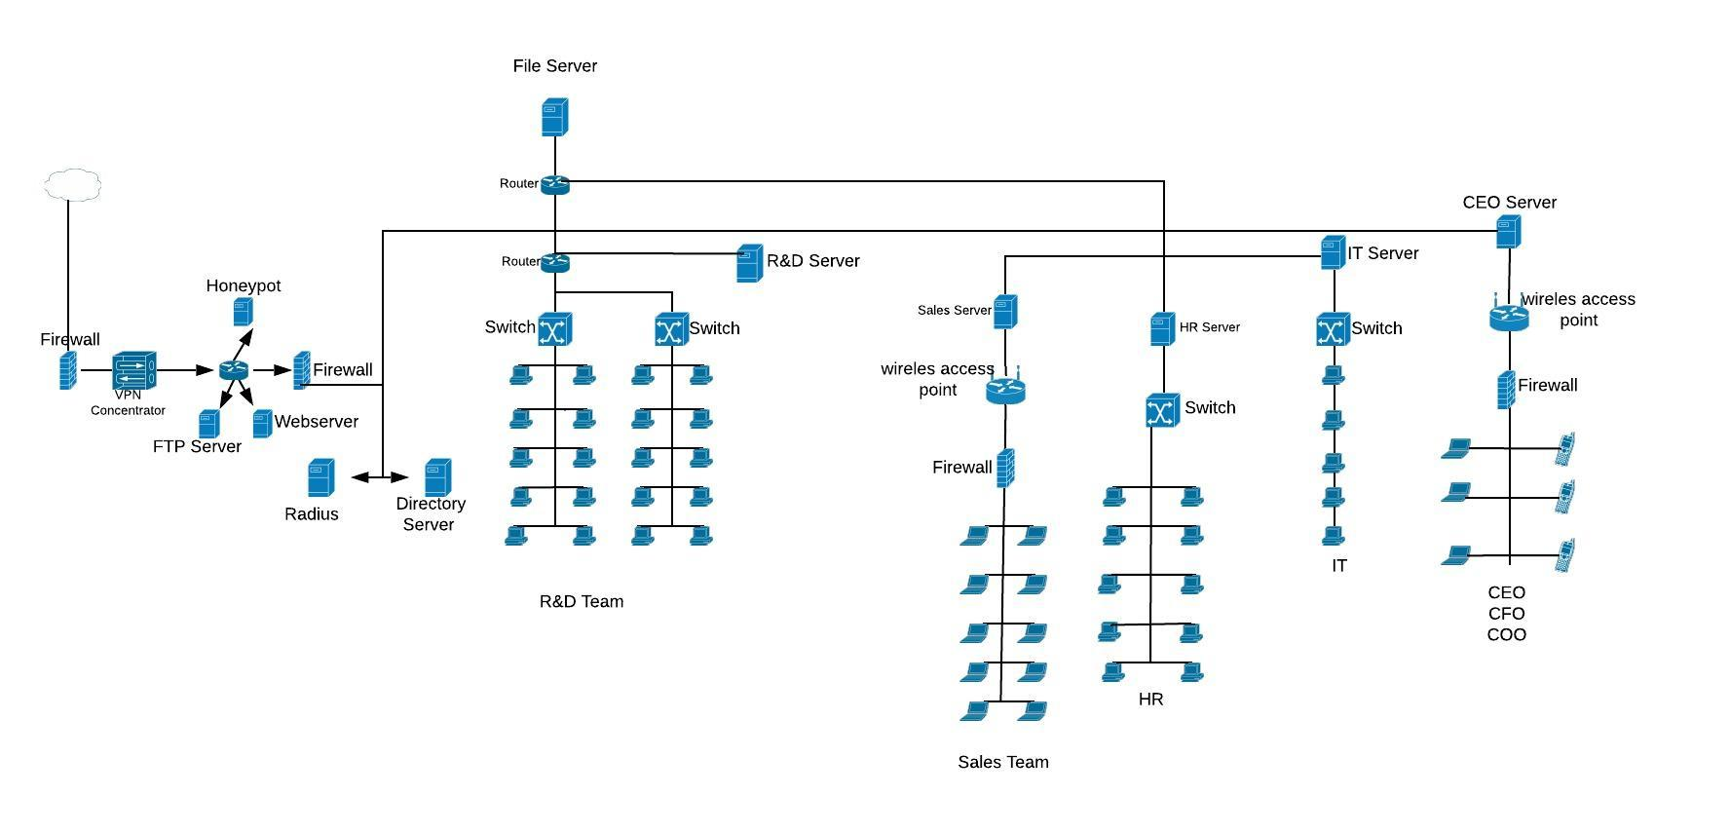
Network Diagram

Slide 9
Network Diagram with Defense Overlay

Slide 10
Malware Analysis

Slide 11
Malware Analysis – MITRE Attack Matrix

Slide 12
Malware Analysis - Forensic Report

Slide 13
Vulnerability Assement

Slide 14
Vulnerability Assement - COG Analysis

Slide 15
Vulnerability Assement – CARVER Matrix

Slide 16
Risk Analysis

Slide 17
Risk Analysis – Risk Management Matrix

Slide 18
Acquisition Management

Slide 19
Proposed Courses of Action
COA 1
COA 2
COA 3

Slide 20
Closing
Concept of Operations/Mission Statement
Questions

